Slide 1
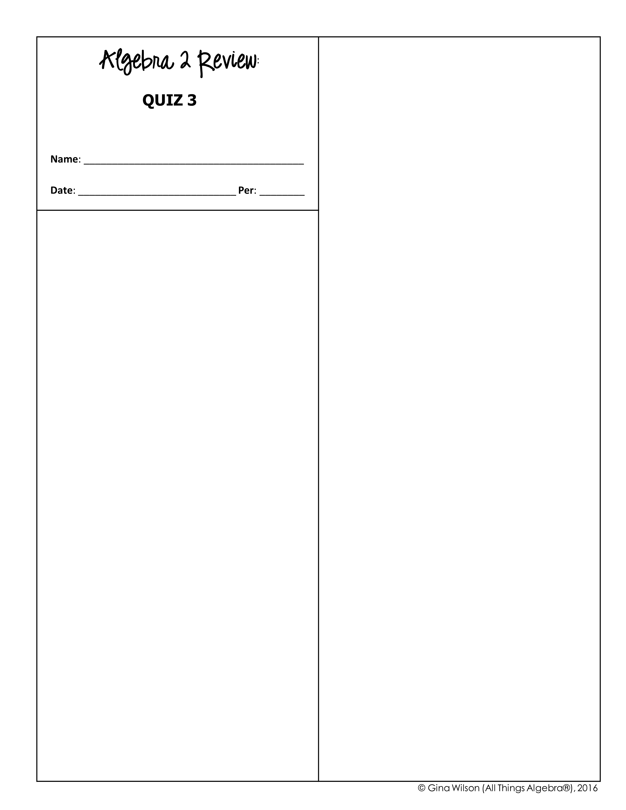
4. Solve for k:
A. C. B. D.
1. Solve for w:
A. C. B. D.
5. Solve for x:
2. Solve for p:
A. C. B. D.
A. C. B. D.
6. Solve for x:
3. Solve for n:
A. No Solution B. C. D.
A. No Solution B. C. D.

Slide 2

7. Which expression is equivalent to ?
12. Solve for x:
A. B. C. D.
8. Which expression is equivalent to ?
A. B. C. D.
A. C. B. D.
9. Solve for a:
13. Solve for c:
A. 1 B. 2 C. 4 D. 8
10. Solve for m:
A. C. B. D.
A. C. B. D.
14. Solve for v to the nearest ten-thousandth:
11. Solve for y:
A. B. C. D.
A. 1.6826 B. 3.6826 C. 1.1761 D. 3.1761

